Slide 1
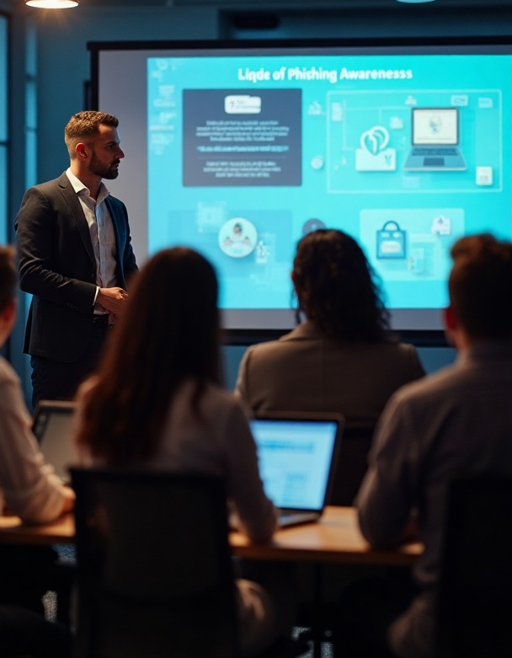
Phishing Awareness Training
Understanding and Preventing Phishing Attacks in the Workplace #CodeAlpha

Slide 2
Introduction
In light of the increasing sophistication of phishing attacks, this presentation serves as a crucial tool for enhancing employee awareness. By exploring the various tactics employed by cybercriminals and understanding their implications, we aim to cultivate a proactive approach to cybersecurity. Moreover, we will outline effective strategies and best practices that organizations can implement to mitigate these risks, ensuring a safer work environment and protecting sensitive information.

Slide 3

01
Phishing Overview

Slide 4
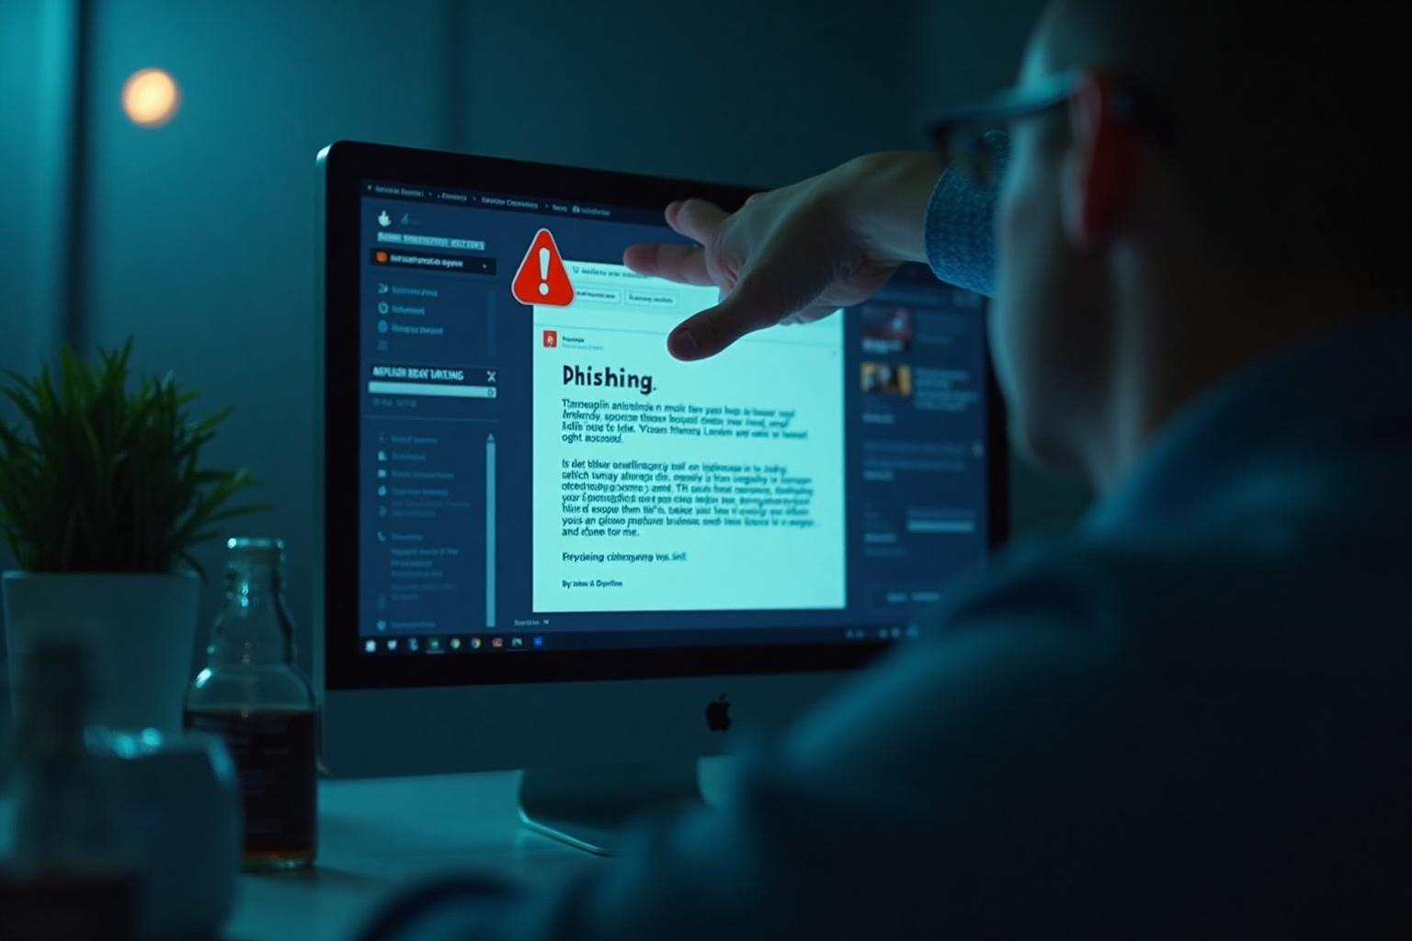
Definition of phishing
Phishing is a cyber-attack method that uses deceptive emails and websites to trick individuals into revealing sensitive information, such as usernames, passwords, and credit card details. Attackers impersonate trustworthy entities to gain access to confidential data, posing significant risks to both individuals and organizations.

Slide 5
Types of phishing attacks
There are several common types of phishing attacks: Email phishing, where attackers send fraudulent emails; Spear phishing, targeting specific individuals or organizations; Whaling, focusing on high-profile targets like executives; and Vishing, or voice phishing, which utilizes phone calls to deceive victims. Each type leverages social engineering tactics to exploit human psychology.

Slide 6
Impact of phishing on organizations
Phishing attacks can have severe financial and reputational consequences for organizations. They lead to data breaches, with potential costs related to regulatory fines, legal fees, and recovery efforts. Additionally, organizations may face loss of customer trust and competitive advantage. The long-term effects can include a damaged brand reputation and decreased employee morale.

Slide 7

02
Prevention Strategies

Slide 8

Identifying phishing attempts
To effectively identify phishing attempts, employees should be trained to recognize suspicious signs such as unexpected requests for sensitive information, generic greetings, and mismatched email addresses. Familiarity with common tactics used by attackers, such as urgency or threatening language, can also help individuals avoid falling victim to these scams.

Slide 9
Safeguarding personal information
Organizations should implement policies that promote the safe handling of personal information. This includes ensuring that sensitive data is encrypted, using secure communication channels, and educating employees on the importance of password security. Regularly updating passwords and employing multi-factor authentication can further protect against unauthorized access.

Slide 10
Reporting suspicious emails
Establishing a clear protocol for reporting suspicious emails is crucial in minimizing the impact of phishing attacks. Employees should know how to report potential threats to the IT department swiftly. Organizations can further encourage vigilance by implementing a reporting tool that allows employees to easily forward suspicious communications, fostering a proactive security culture.

Slide 11
Conclusions
Phishing remains a prevalent threat, but with proper awareness and preventive strategies, organizations can significantly reduce their risks. By focusing on employee education, identifying threats, safeguarding information, and fostering a culture of reporting, companies can create a safer cyber environment.

Slide 12
Thank you!
Muhammad Zain Latif
#CodeAlpha

